Slide 1

NewMoms
Personal pregnancy data analytics app
for postpartum depression
Notes:
HI EVERYONE OUR PRODUCT IS CALLED NEW MOMS AND WE’RE EXCITED TO PITCH YOU OUR SOLUTION FOR POSTPARTUM DEPRESSION IN LOW INCOME WOMEN
The need- Alex
Ethical/health
Ppl affected
Social predisposition
Market- Alex N
How much does PPD cost society
$7,200 per mom
Competitive landscape
https://www.ncbi.nlm.nih.gov/pmc/articles/PMC5650672/
The app- Stephanie
So why an app?
Accessibility
Cell phone penetration
Incentive
Future directions - what do we need to do to make the app
Funding pathways
Ethical/health stats
Cost to the system
Why an app/The idea
The funding pathways
Why fund us (social determinants, cost of PPD)

Slide 2


1 in 7 women will experience postpartum depression
1 in 4 women of low socioeconomic status will experience postpartum depression
Source: AMHCA
Notes:
Postpartum depression, also known as PPD, affects 1 in 7 woman in the US but in lower socioeconomic areas 1 in 4 women are affected.
900,000 women suffer from postpartum depression annually in the US

Slide 3

Postpartum Depression
Notes:
PPD is a mental health illness experienced by women after childbirth. Some symptoms include but are not limited to anxiety, mothers experiencing difficulty bonding with their baby, and a constant depressed mood. Women who experience PPD without receiving proper treatment are at risk of suffering chronic and recurrent depression throughout their life and unfortunately this can lead to suicide. PPD not only affects the mother, but can also lead to a weak maternal-infant attachment that may affect the child’s emotional behavior and cognitive skills.

Slide 4
NewMoms
Improved Access to Clinical and Mental Health Resources for Postpartum Women
Notes:
NewMoms is an app that improves access to clinical and mental health resources for postpartum women.

Slide 5
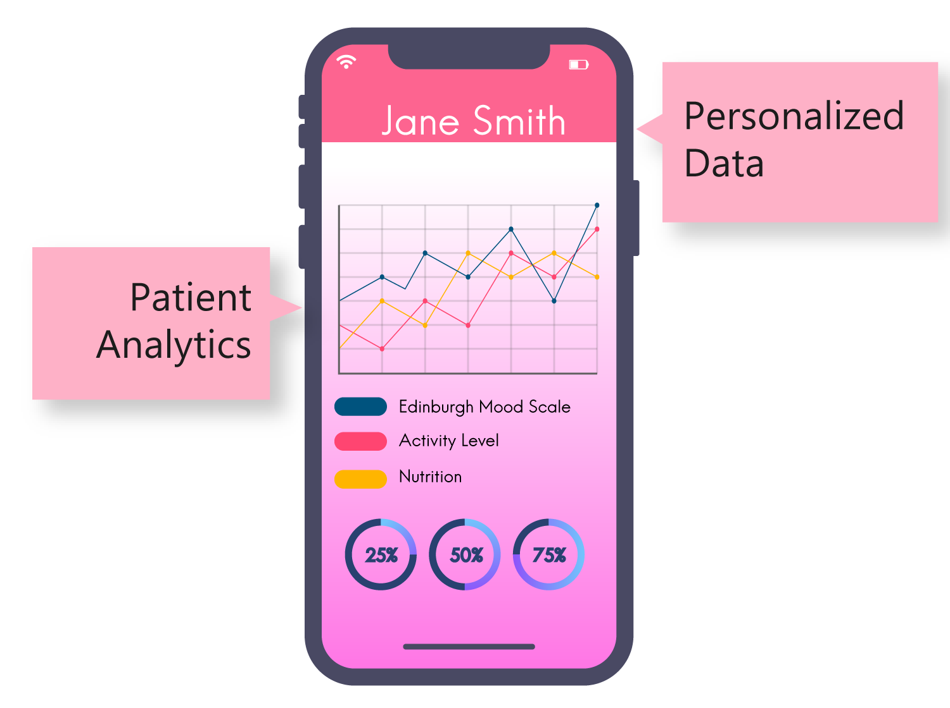
Data Visualization
Simple
Easy-to-use
Health Graphics
Notes:
It provides a system to consistently track pregnant and postpartum women's mental state via a short 3 question survey based on the recognized gold standard screening test every few days. The app’s goal is regular data collection, shown in an easy to read visual interface that allows users to see their mental state in a linear, visual representation so that they can easily detect changes and potential incidence of postpartum depression. This way, if a woman’s mental health state falls below a certain level, we can suggest that they see a clinician.

Slide 6

Partnering Manufacturers
Procter & Gamble (P&G)
Johnson & Johnson
Unilever
Notes:
The app will implement an incentive structure using gamification in which consistent usage rewards the user with coupons for childcare products. For example, if the mother completes the depression screening test three times in a week, she could receive a coupon for $10 off Pampers diapers. Potential partners that we could work with include sponsor companies such as Johnson and Johnson, P&G, and Unilever

Slide 7
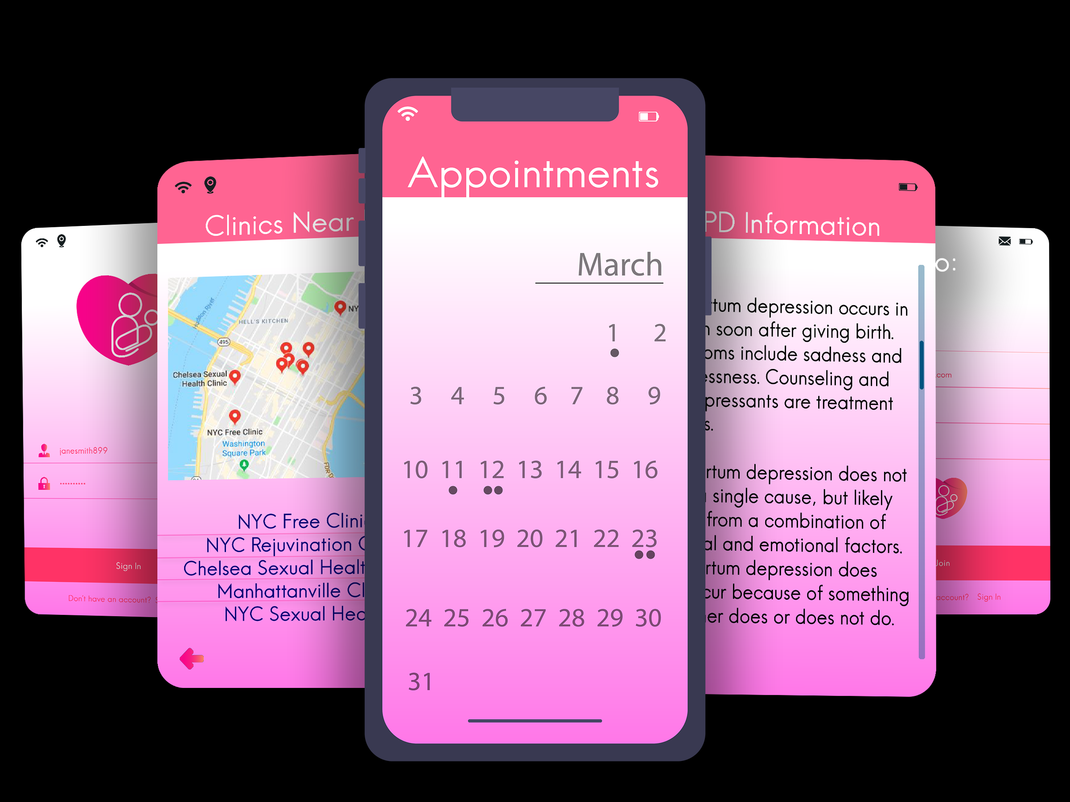
Additional features
Notes:
Other app features include resources with mental health and postpartum health information, a clinic referral system, and an appointment tracker.
These features would serve to provide educational services about mental and postpartum health, especially to new mothers. A clinic referral system would guide mothers to experienced and caring physicians at participating healthcare providers. Finally, an appointment tracker will notify women on when they should go to receive medical attention.

Slide 8
Impact
Accessibility
Personalized
Care
Incentive
Notes:
This app effectively improves accessibility for low-income mothers. Recent studies have shown that there is a continuing increase in low income individuals in the US who are using smartphones.
In addition, the incentive structure is particularly applicable to our target population, who would greatly benefit from coupons for products such as diapers and baby food and health information that do not require in-person visits with clinicians.
The app finally seeks to combine many resources into a single easy-to-use medium. This takes a holistic approach to a health pain-point while still remaining personalized to our at-risk population.

Slide 9
$5.7 billion
Annually for untreated maternal depression
Source: AMHCA
Notes:
.
This app would also save $5.7 billion in lost income and productivity in the US. This lost productivity has a significant impact on mothers who are trying to provide for their families, especially in low-income settings.
The AMHCA states that the annual cost of not treating a mother with depression - in lost income and productivity alone - is $7,200. If you extrapolate that out to 800,000 mothers each year, that means the annual cost of untreated maternal depression in the US is $5.7 billion dollars

Slide 10






Funding Streams
Angel Investment
NGO
State-funding
Crowd-sourcing
Notes:
NGO
-Bill Gates
-World Bank
-Merck for mothers
State funding
-AHEC
Crowd-sourcing
-GoFundMe

Slide 11
Notes:
Future steps in understanding if NewMoms will be a viable product is to look further into the current patent landscape and conduct preliminary market research. The voice of customer analysis would focus around rural communities since a main goal of the app is to increase accessibility to care. Since the app would have a relatively low cost footprin

Slide 12
What is PPD?
https://www.who.int/mental_health/prevention/suicide/lit_review_postpartum_depression.pdf
https://www.cdc.gov/reproductivehealth/depression/ - affects 1in 9 pregnant women and that statistic increases based on socioeconomic status
https://www.apa.org/pi/women/resources/reports/postpartum-depression.aspx - 1 in every 7 women “Early detection and treatment make all the difference.”

Slide 13
Current Solutions
Edinburgh Postnatal Depression Scale
Sleep Intervention
Loss of Libido
Notes:
According to the world health organization, the Edinbueg scale is By far the most widely used instrument in postpartum depression studies and for population-based screening is the Edinburgh Postnatal Depression Scale (EPDS), a 10-item self-report scale specifically designed to screen for postpartum depression in community samples.
https://www.who.int/mental_health/prevention/suicide/lit_review_postpartum_depression.pdf

